Slide 1
Distributed Deadlock
Mayuri Wadkar

Slide 2
What is a distributed deadlock?
The same conditions for deadlock in uniprocessors apply to distributed systems.
A deadlock is a condition in a system where a set of processes (or threads) have requests for resources that can never be satisfied. Essentially, a process cannot proceed because it needs to obtain a resource held by another process but it itself is holding a resource that the other process needs.
Types of deadlocks
Communication Deadlock
Occurs when Process A is trying to send a message to process B, which is trying to send a message to Process C, which is trying to send a message to A.
Resource Deadlock
Occurs when processes are trying to get exclusive access to devices, files, locks, servers, or other resources.

Slide 3
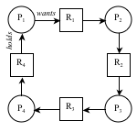
When distributed deadlock occurs?
Distributed deadlocks can occur in distributed systems when distributed transactions or concurrency control is being used.
Four conditions to be met for a deadlock to occur
Mutual exclusion
Hold and wait
Non-preemption
Circular wait

Slide 4
Four strategies to handle deadlock:
Ignorance: ignore the problem; assume that a deadlock will never occur. This is a surprisingly common approach.
Detection: let a deadlock occur, detect it, and then deal with it by aborting and later restarting a process that causes deadlock.
Prevention: make a deadlock impossible by granting requests so that one of the necessary conditions for deadlock does not hold.
Avoidance: choose resource allocation carefully so that deadlock will not occur. Resource requests can be honored as long as the system remains in a safe (non-deadlock) state after resources are allocated.

Slide 5
Distributed deadlock prevention
If we can deny at least one of the four conditions defined by Coffman, then we will not have deadlock.
Mutual Exclusion
To deny this means that we will allow a resource to be held (used) by more than one process at a time. If a resource can be shared then there is no need for mutual exclusion and deadlock cannot occur. Too often, however, a process requires mutual exclusion for a resource because the resource is some object that will be modified by the process.
Hold and wait
Denying this means that processes that hold resources cannot wait for another resource. This typically implies that a process should grab all of its resources at once. This is not practical either since we cannot always predict what resources a process will need throughout its execution.

Slide 6
Distributed deadlock prevention
Non-preemption
In transactional systems, allowing preemption means that a transaction can come in and modify data (the resource) that is being used by another transaction. This differs from mutual exclusion since the access is not concurrent but the same problem arises of having multiple transactions modify the same resource. We can support this with optimistic concurrency control algorithms that will check for out-of-order modifications at commit time and roll back (abort) if there are potential inconsistencies.
Circular wait
Avoiding circular wait means that we ensure that a cycle of waiting on resources does not occur. We can do this by enforcing an ordering on granting resources and aborting transactions or denying requests if an ordering cannot be granted.

Slide 7
Distributed deadlock prevention
Wait-die algorithm for avoiding Circular Waits :
One way is by obtaining a globally-unique timestamp (e.g., Lamport total ordering) for every transaction so that no two transactions get the same timestamp. When one process is about to block waiting for a resource that another process is using, check which of the two processes has a younger timestamp and give priority to the older process.
If a younger process is using the resource,
then the older process (that wants the resource) waits.
If an older process is holding the resource,
the younger process (that wants the resource) aborts itself.

Slide 8
Distributed deadlock prevention
Wound-wait algorithm for avoiding Circular Waits:
A variant of wait-die algorithm
An old process aborts the younger process that holds a resource. If a younger process wants a resource that an older one is using, then it waits until the older process is done.
In this case, the graph flows from young to old and cycles are again impossible.

Slide 9
Chandy-Misra-Hass Detection Algorithm
If a process makes a request for a resource which fails or times out,
the process generates a probe message and sends it to each of the processes holding one or more of its requested resources.
When a process receives a probe message,
it checks to see if it is also waiting for resources.
If not, it is currently using the needed resource
and will eventually finish and release the resource.
If it is waiting for resources, it passes on the probe message to all processes it knows to be holding resources it has itself requested.
The process first modifies the probe message, changing the sender and receiver ids.
If a process receives a probe message that it recognizes as having initiated,
it knows there is a cycle in the system
and thus, deadlock.

Slide 10
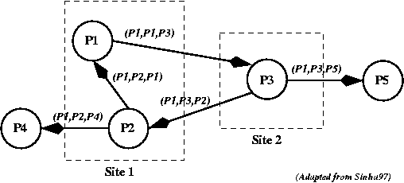
Chandy-Misra-Hass Detection Algorithm
Example
In this case P1 initiates the probe message, so that all the messages shown have P1 as the initiator.
When the probe message is received by process P3, it modifies it and sends it to two more processes.
Eventually, the probe message returns to process P1. Deadlock!

Slide 11
Thank You !!

